Slide 1
Apache Hadoop

Slide 2

Historical Review of Big Data

Slide 3
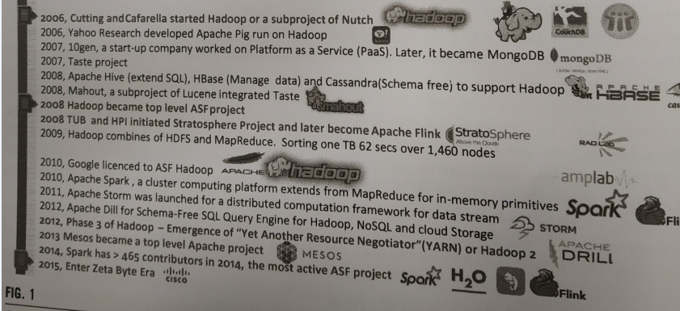

Slide 4
Apache Hadoop
Apache Hadoop is an open source software framework for storage and large scale processing of data-sets on clusters of commodity hardware.
Hadoop was created by Doug Cutting and Mike Cafarella in 2005.

Slide 5

Doug Cutting , who was working at Yahoo! at the time
He named the project after his son's toy elephant.
Cutting's son was 2 years old at the time and just beginning to talk. He called his beloved stuffed yellow elephant "Hadoop"

Slide 6
The Apache Hadoop framework modules
Hadoop Common: contains libraries and utilities needed by other Hadoop modules
Hadoop Distributed File System (HDFS): a distributed file-system that stores data on the commodity machines, providing very high aggregate bandwidth across the cluster
Hadoop YARN: a resource-management platform responsible for managing compute resources in clusters and using them for scheduling of users' applications
Hadoop MapReduce: a programming model for large scale data processing

Slide 7
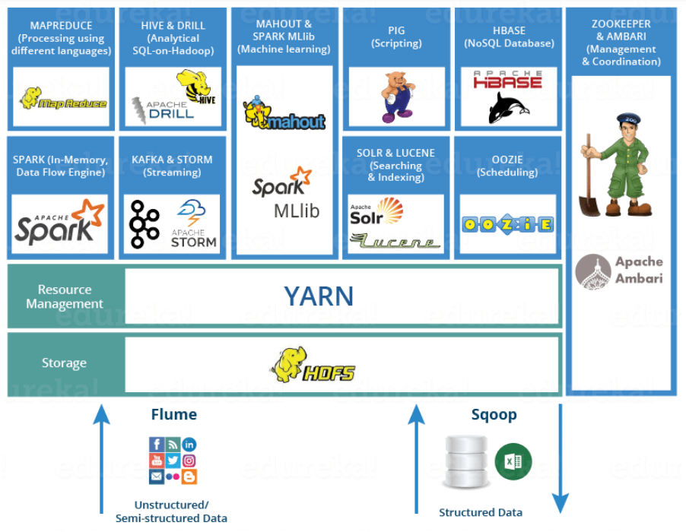
Notes:
✅ Example Use Case Flow
Live GPS + weather logs → Flume → HDFS.
Historical traffic from MySQL → Sqoop → HDFS.
Spark calculates hourly averages, trains ML model for prediction.
Hive queries generate reports for government dashboards.
Kafka + Storm for real-time congestion alerts.
HBase stores real-time snapshots; Solr indexes for quick search.
Oozie schedules daily aggregation jobs.

Slide 8
Hadoop Distributed file system
HDFS is a filesystem designed for storing very large files with streaming data access patterns, running on clusters of commodity hardware

Slide 9
HDFS is not good fit for following
Low-latency data access
Lots of small files
Multiple writers and arbitrary file modifications
Notes:
Low-latency accessHDFS is built for big file transfers, not instant access.Lots of small filesToo many small files overwhelm the NameNode's memory.Multiple writers/editsHDFS is not a shared whiteboard; it's like a printed book — you can't rewrite it.

Slide 10
HDFS concepts
Block size
HDFS block size
Difference between HDFS and other file system
Why is a block size in HDFS so large?
Notes:
HDFS blocks are large compared to disk blocks, and the reason is to minimize the cost of seeks. If the block is large
enough, the time it takes to transfer the data from the disk can be significantly longer than the time to seek to the start
of the block. Thus, transferring a large file made of multiple blocks operates at the disk transfer rate.
A quick calculation shows that if the seek time is around 10 ms and the transfer rate is 100 MB/s, to make the seek
time 1% of the transfer time, we need to make the block size around 100 MB. The default is actually 128 MB,
although many HDFS installations use larger block sizes. This figure will continue to be revised upward as transfer
speeds grow with new generations of disk drives.
A seek is the time the disk takes to move its head to the correct place to read data. If blocks are small, the disk has to seek again and again for each block.
That wastes time and slows down the overall process.
Time to transfer 100 MB at 100 MB/sec = 1 second
Seek time = 10 ms = 0.01 second
0.01 s is 1% of 1 second ✔

Slide 11
HDFS services
Name Node
Secondary Name node
Job Tracker
Data Node
Task Tracker

Slide 12

Name Node
File.txt :440 MB
a.txt : 1,2
b.txt: 3
c.txt : 5
d.txt :7
Request
Client
Acknowledgement 1,3,5,7
b.txt
File.txt : input file
440MB : File size
a.txt
Data Node
1
Data Node
2
Data Node
3
Data Node
4
Input Splits
a.txt : 128 MB
b.txt : 128 MB
c.txt : 128 MB
d.txt : 56 MB
c.txt
d.txt
Data Node
5
Data Node
6
Data Node
7
Data Node
8

Slide 13
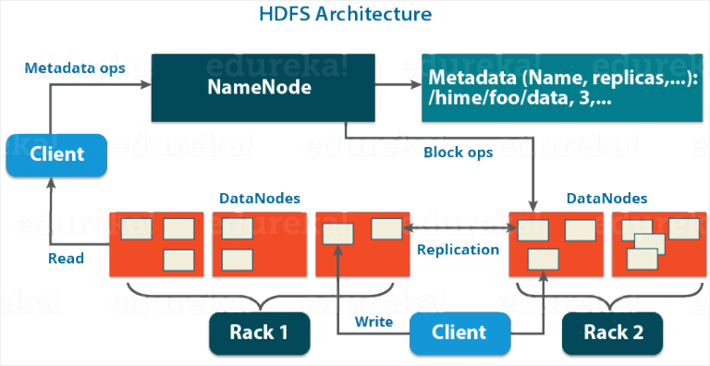
HDFS Architecture
Notes:
1. Client
Acts as the user or application interface to interact with the HDFS.
Can perform read and write operations.
Communicates with the NameNode to get metadata and with DataNodes to read/write actual data.
2. NameNode (Master Node)
The central coordinator of the HDFS.
Does not store actual data, only metadata.
Metadata includes:
File names and paths
Block locations
Replication factor (e.g., 3 copies)
Permissions and file sizes
Maintains this metadata in RAM for fast access.
Responds to metadata requests from clients.
3. Metadata
Stored only on the NameNode.
Contains key-value mappings like:
4. DataNodes (Worker Nodes)
Actual storage units that store the file data in blocks (default size: 128 MB).
Data is split into blocks, and each block is replicated (typically 3 times) across different DataNodes for fault tolerance.
Each DataNode sends a heartbeat and block report to the NameNode regularly to confirm it is alive and healthy.
5. Racks
DataNodes are grouped in racks, which represent the physical network location (like different switches in a data center).
HDFS uses rack awareness:
Tries to spread replicas across racks.
Ensures data availability even if a whole rack fails.
Example: If one copy is in Rack 1, another is placed in Rack 2.

Slide 14
NameNode
NameNode is the master node in the Apache Hadoop HDFS Architecture that maintains and manages the blocks present on the DataNodes (slave nodes).
NameNode is a very highly available server that manages the File System Namespace and controls access to files by clients.

Slide 15
Functions of Namenode
It is the master daemon that maintains and manages the DataNodes (slave nodes)
It records the metadata of all the files stored in the cluster
FsImage: It contains the complete state of the file system namespace since the start of the NameNode.
EditLogs: It contains all the recent modifications made to the file system with respect to the most recent FsImage.

Slide 16
HDFS metadata (such as file creation, deletion, and block replication) in chronological order.
Purpose: It ensures that all changes are captured and can be replayed to reconstruct the current
state of the file system after a restart or crash.
txn_id=1001, timestamp=2024-08-01 10:00:00, operation=MKDIR, path=/user/data
txn_id=1002, timestamp=2024-08-01 10:05:00, operation=CREATE, path=/user/data/file1.txt, replication=3, blocksize=128MB
txn_id=1003, timestamp=2024-08-01 10:06:00, operation=RENAME, src=/user/data/file1.txt, dst=/user/data/file1_renamed.txt
txn_id=1004, timestamp=2024-08-01 10:07:00, operation=DELETE, path=/user/data/file1_renamed.txt
txn_id=1005, timestamp=2024-08-01 10:08:00, operation=SET_REPLICATION, path=/user/data/file2.txt, replication=2

Slide 17
FSImage is a snapshot of the entire file system's metadata at a specific point in time.
It represents the state of the file system when it was last saved.
Purpose: It allows the NameNode to load the current state of the file system quickly during startup,
without replaying all the transactions from the Edit Log.

Slide 18
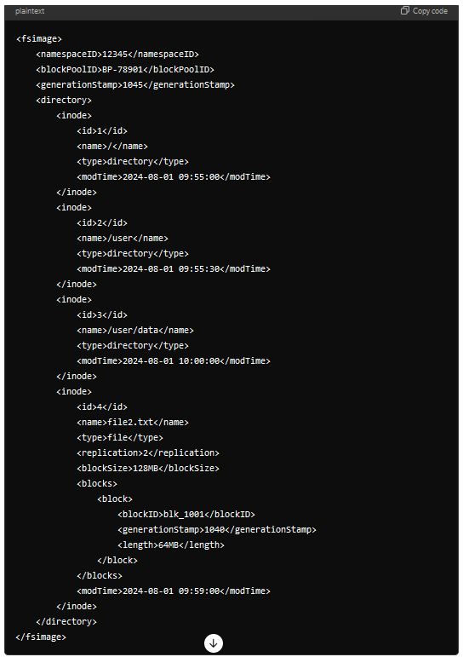

Slide 19
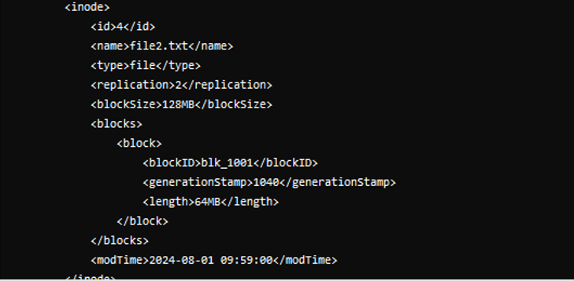

Slide 20
Continue…
It records each change that takes place to the file system metadata.
It regularly receives a Heartbeat and a block report from all the DataNodes in the cluster to ensure that the DataNodes are live.
It keeps a record of all the blocks in HDFS and in which nodes these blocks are located.
The NameNode is also responsible to take care of the replication factor of all the blocks .
In case of the DataNode failure, the NameNode chooses new DataNodes for new replicas, balance disk usage and manages the communication traffic to the DataNodes.

Slide 21
Data Nodes
DataNodes are the slave nodes in HDFS. Unlike NameNode, DataNode is a commodity hardware, that is, a non-expensive system which is not of high quality or high-availability.

Slide 22
Functions of Data Node
These are slave daemons or process which runs on each slave machine.
The actual data is stored on DataNodes.
The DataNodes perform the low-level read and write requests from the file system’s clients.
They send heartbeats to the NameNode periodically to report the overall health of HDFS, by default, this frequency is set to 3 seconds.

Slide 23
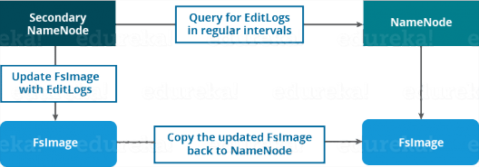
Secondary NameNode
Apart from these two daemons, there is a third daemon or a process called Secondary NameNode. The Secondary NameNode works concurrently with the primary NameNode as a helper daemon.

Slide 24
Functions of Secondary NameNode
The Secondary NameNode is one which constantly reads all the file systems and metadata from the RAM of the NameNode and writes it into the hard disk or the file system.
It is responsible for combining the EditLogs with FsImage from the NameNode.
It downloads the EditLogs from the NameNode at regular intervals and applies to FsImage. The new FsImage is copied back to the NameNode, which is used whenever the NameNode is started the next time.

Slide 25
1. Checkpointing:
The primary function of the Secondary NameNode is to periodically merge the Edit Log and the FSImage (File System Image) stored by the NameNode. This process is known as checkpointing.
The Edit Log is a file where the NameNode records every change made to the HDFS, while the FSImage is a snapshot of the filesystem's metadata at a certain point in time.
Over time, the Edit Log can grow very large, making the recovery process slow and cumbersome because the NameNode would need to replay all the transactions from a potentially large Edit Log to rebuild the filesystem state.
The Secondary NameNode periodically downloads the current FSImage and Edit Log from the NameNode, merges them into a new FSImage, and then uploads this new FSImage back to the NameNode. The Edit Log is then truncated to start fresh.
2. Reducing NameNode Load:
By performing the checkpointing task, the Secondary NameNode helps reduce the workload on the NameNode. The NameNode does not have to continuously merge the Edit Log and FSImage, as this is handled by the Secondary NameNode at intervals.
3. Assisting in Recovery:
In the event of a NameNode failure, the Secondary NameNode’s latest checkpointed FSImage and a much smaller Edit Log can be used to restart the NameNode more quickly. However, it is important to note that the Secondary NameNode itself does not automatically take over in case of a NameNode failure; it simply provides the latest metadata to assist in recovery.

Slide 26
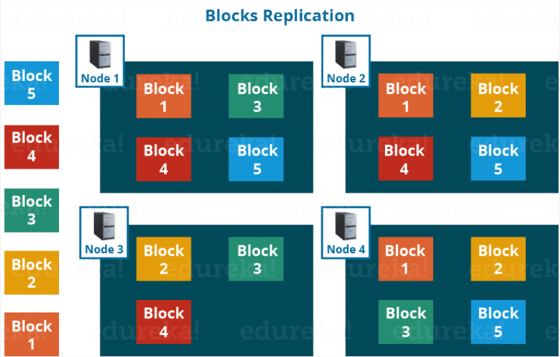
Replication Management
if you are storing a file of 128 MB in HDFS using the default configuration, you will end up occupying a space of 384 MB (3*128 MB) as the blocks will be replicated three times and each replica will be residing on a different DataNode.
Notes:
Provides rack-awareness
Minimizes data loss if an entire rack fails
Ensures network efficiency by keeping one replica close to the client

Slide 27
NETWORK TOPOLOGY AND HADOOP
What does it mean for two nodes in a local network to be “close” to each other?
Processes on the same node
Different nodes on the same rack
Nodes on different racks in the same data center
Nodes in different data centers

Slide 28
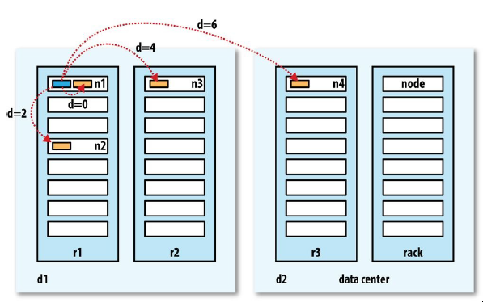

Slide 29
For example, imagine a node n1 on rack r1 in data center d1. This can be represented as /d1/r1/n1. Using this notation, here are the distances for the four scenarios:
distance(/d1/r1/n1, /d1/r1/n1)
= 0 (processes on the same node)
distance(/d1/r1/n1, /d1/r1/n2)
= 2 (different nodes on the same rack)
distance(/d1/r1/n1, /d1/r2/n3)
= 4 (nodes on different racks in the same data center)
distance(/d1/r1/n1, /d2/r3/n4)
= 6 (nodes in different data centers)

Slide 30
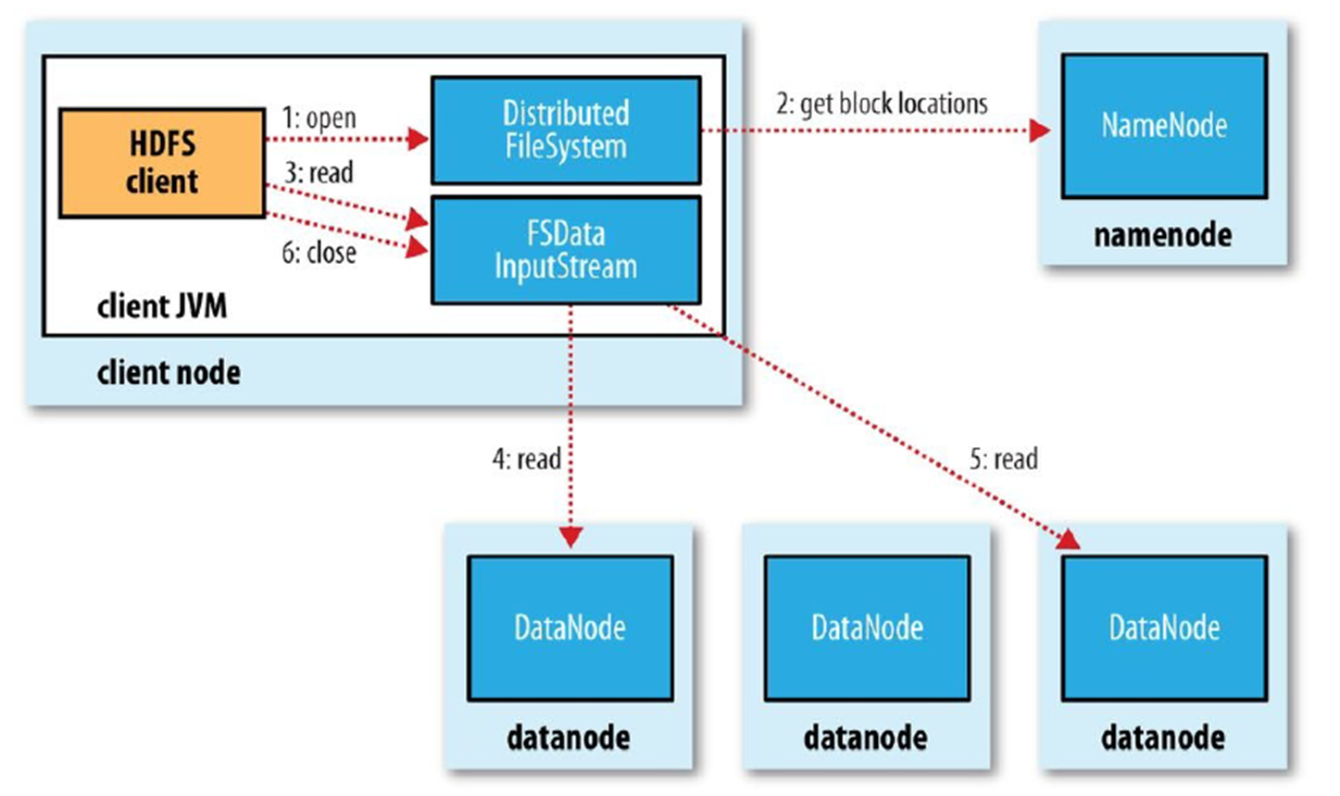
Open Request: The HDFS client initiates a read by calling open() on the FileSystem (specifically an instance of DistributedFileSystem) within its JVM.
Request Block Locations: The DFS contacts the NameNode (via RPC), which checks permissions and returns the locations (IP addresses) of DataNodes storing the relevant blocks of the file. The NameNode also issues a security token.
Read from DataNodes: The client, now equipped with block locations and token, uses an FSDataInputStream. This stream manages connections, contacting the closest DataNode containing the first block.
Block Streaming: The DataNode streams the requested block to the client. As more blocks need reading, the client transparently switches to appropriate DataNodes. The DataNode reads use an internal queue for managing data transfer buffers.
Repeat Until Done: Steps 3 and 4 repeat for all blocks. If further block locations are needed, the stream asks the NameNode again.
Close: After reading all data, the client calls close() on the input stream, shutting down the process
Anatomy of File Read

Slide 31
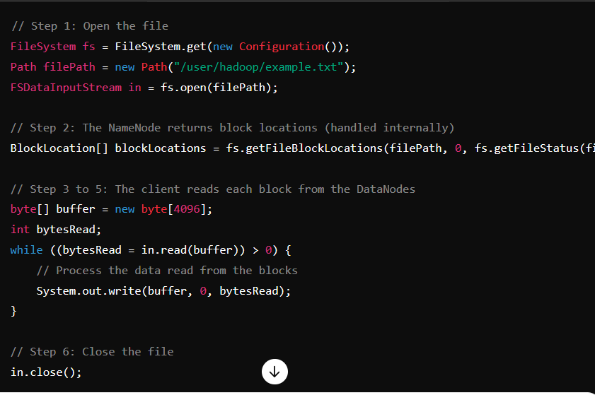

Slide 32
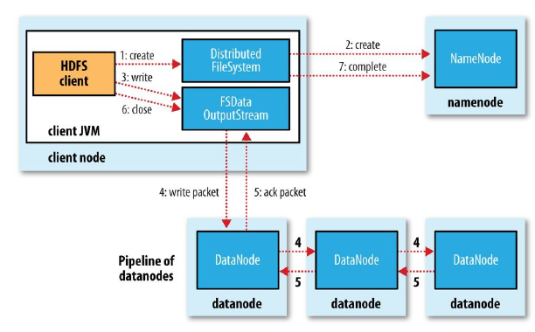
Create Request: The client calls create() on the DistributedFileSystem.
File Metadata Creation: The DFS requests the NameNode to create the file entry in the namespace (without associating data blocks yet). The NameNode verifies permissions and that the filename is unique.
FSDataOutputStream & Queues:
The DFS returns an FSDataOutputStream to the client.
As the client writes data, the DFSOutputStream splits the data into packets and places them in an internal Data Queue.
DataStreamer component consumes the data queue. It requests the NameNode to allocate blocks and selects a pipeline of DataNodes for replication (usually three nodes).
Packets are sent sequentially: to the first DataNode, which stores and forwards to the second, and so on.
4. Pipeline Replication:
Each Data Node in the pipeline stores the data packet and forwards it until all replicas are made
Anatomy of File Write
5. Acknowledgment Queue:
The output stream maintains an Ack Queue for packets waiting for acknowledgment from DataNodes.
DataNodes send ACKs upstream (third to second to first), and only after all ACKs are received for a packet is it removed from the ack queue.

Slide 33
Data Queue: Holds data packets waiting to be sent to DataNodes. Managed by the DataStreamer thread.
Ack Queue: Holds packets that have been sent but are awaiting acknowledgment from all DataNodes in the pipeline.
Only after DataNodes respond with ACK (packet has been flushed to disk) is a packet removed from the ack queue. If an error occurs or timeout, error handling is triggered, possibly removing the problematic DataNode from the pipeline.

Slide 34
Configuration XML files in Hadoop
hadoop-env.sh
This file specifies environment variables that affect the JDK used by Hadoop Daemon (bin/hadoop). (JAVA_HOME)
It informs Hadoop daemon where NameNode runs in the cluster. It contains the configuration settings for Hadoop Core such as I/O settings that are common to HDFS and MapReduce.

Slide 35
hdfs-site.xml
This is the main configuration file for HDFS. It defines the namenode and datanode paths as well as replication factor.
Replication factor is specified by dfs.replication property; as it is a single node cluster hence we will set replication to 1.
The default heartbeat interval is 3 seconds. One can change it by using dfs.heartbeat.interval in hdfs-site.xml.
mapred-site.xml
In order to specify which framework should be used for MapReduce, we use mapreduce.framework.name property, yarn is used here.

Slide 36
yarn-site.xml
In order to specify auxiliary service need to run with nodemanager “yarn.nodemanager.aux-services” property is used.
Here Shuffling is used as auxiliary service. And in order to know the class that should be used for shuffling we user “yarn.nodemanager.aux-services.mapreduce.shuffle.class”
core-site.xml
This file defines port number, memory, memory limits, size of read/write buffers used by Hadoop. Find this file in the etc/hadoop directory
Location of namenode is specified by fs.defaultFS property namenode running at 9000/9870 port on localhost.
hadoop.tmp.dir property to specify the location where temporary as well as permanent data of Hadoop will be stored.

Slide 37
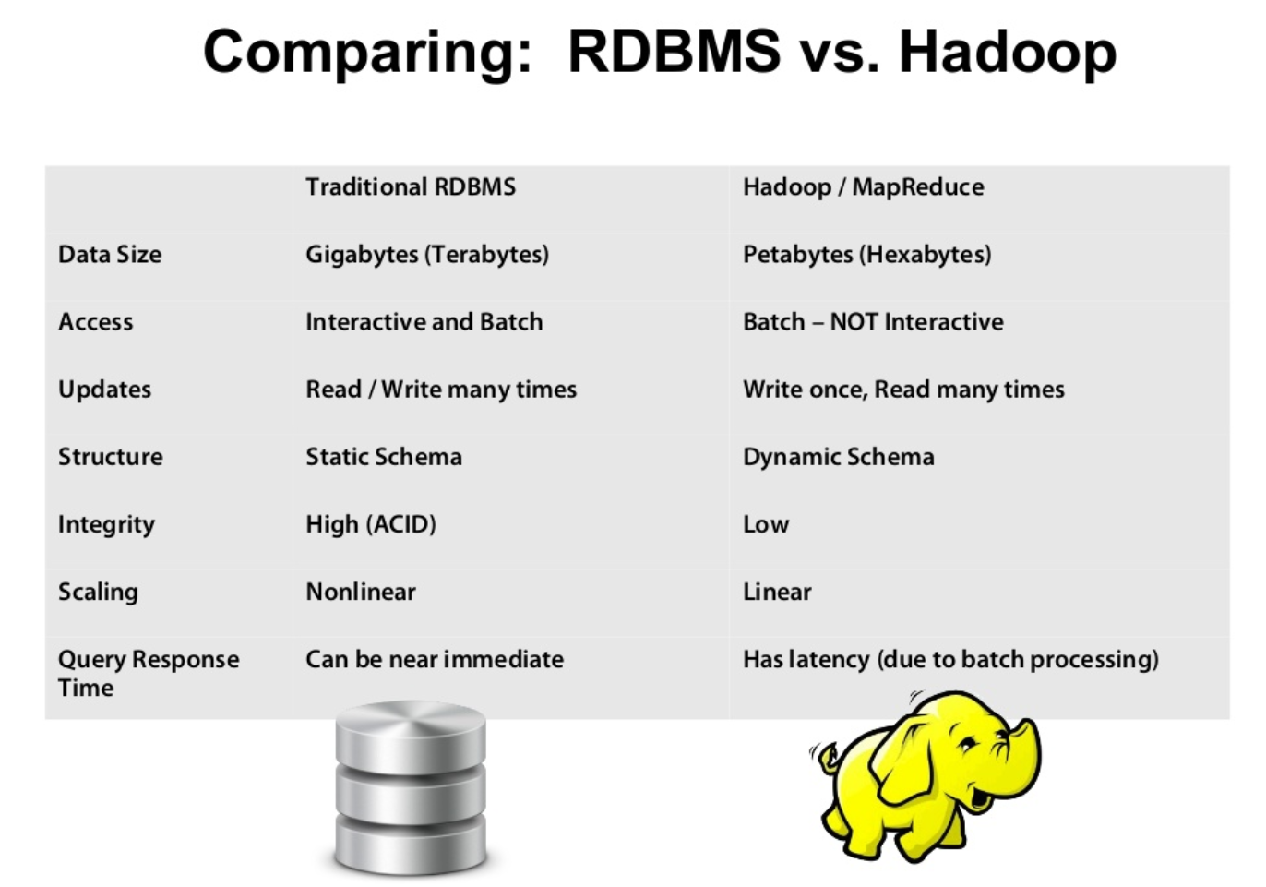
In transaction processing, ACID (atomicity, consistency, isolation, and durability) is an acronym and mnemonic device used to refer to the four essential properties a transaction should possess to ensure the integrity and reliability of the data involved in the transaction.

Slide 38
S.No. | RDBMS | Hadoop
1. | Traditional row-column based databases, basically used for data storage, manipulation and retrieval. | An open-source software used for storing data and running applications or processes concurrently.
2. | In this structured data is mostly processed. | In this both structured and unstructured data is processed.
3. | It is best suited for OLTP environment. | It is best suited for BIG data.
4. | It is less scalable than Hadoop. | It is highly scalable.
5. | Data normalization is required in RDBMS. | Data normalization is not required in Hadoop.
6. | It stores transformed and aggregated data. | It stores huge volume of data.
7. | It has no latency in response. | It has some latency in response.
8. | The data schema of RDBMS is static type. | The data schema of Hadoop is dynamic type.
9. | High data integrity available. | Low data integrity available than RDBMS.
10. | Cost is applicable for licensed software. | Free of cost, as it is an open source software.

